Slide 1
Self-Organizing Search and Retrieve Cellular Automata
Bennett Breese, Ethan Fitz, Benjamin Russ

Slide 2
Overview
Agents must work collaboratively to move objects to a target locations via stigmergic communication via pheromones.
Agents have 3 distinct modes:
Searching
Agents probabilistically move through environment based on pheromone values present.
Retrieval
  Agent drops beacon pheromone to attract other agents.
Homing
  Agents move object south to the designated target area.
Searching
Homing
Retrieval

Slide 3
Pheromones
Agents can drop repulsive and attractive/beacon pheromones in the environment. The only difference between the two types are that attractive pheromones are positive, and the repulsive pheromones are negative.
In the case where both pheromones are present, the two types are summed together for a net pheromone value.

Slide 4
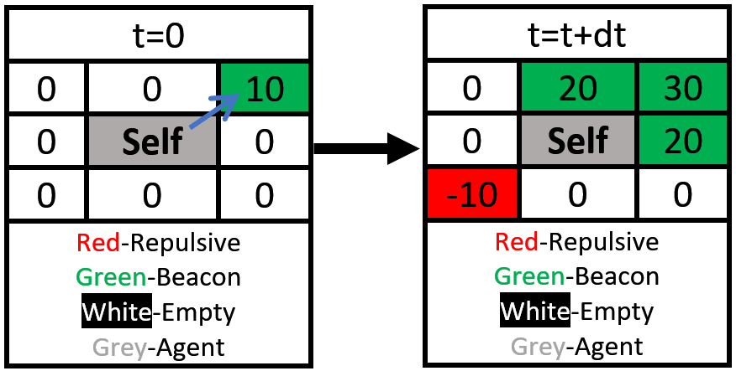
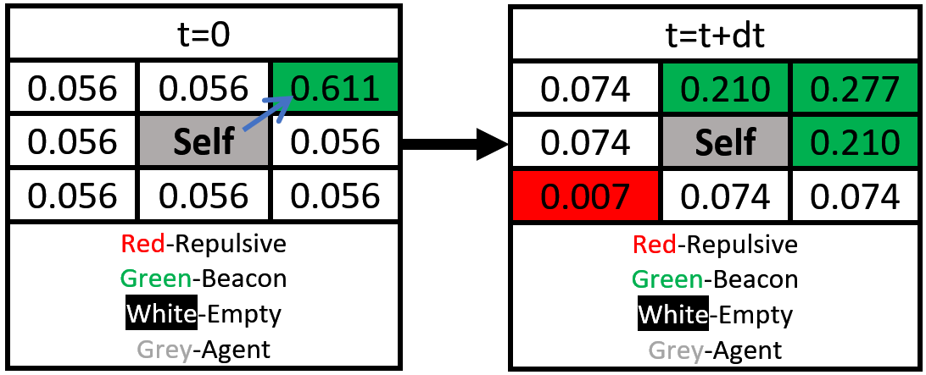
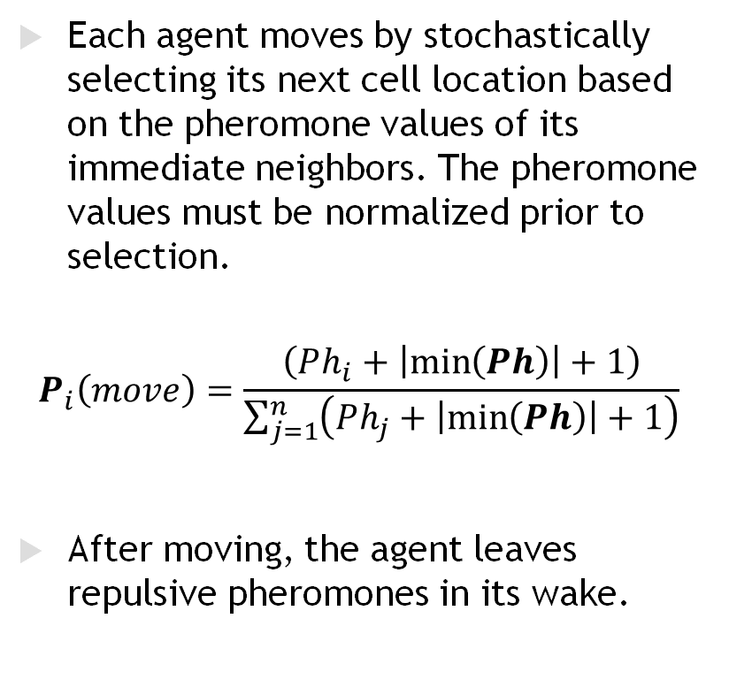
Agent Searching & Stochastic Movement
Each agent moves by stochastically selecting its next cell location based on the pheromone values of its immediate neighbors. The pheromone values must be normalized prior to selection.
$$P_{i}\left(move\right)=\frac{\left(Ph_{i}+\left|\min\left(Ph\right)\right|+1\right)}{\sum_{j=1}^{n}{\left(Ph_{j}+\left|\min\left(Ph\right)\right|+1\right)}}$$
After moving, the agent leaves repulsive pheromones in its wake.
Convert to Probabilities

Slide 5
Collaborative Object Retrieval
Once the agent finds an object in one of the neighboring cells, it attempts to move it. However, each object has a randomly assigned weight to it, or minimum number of agents required to move it.
If the agent is unable to move the object, it drops an attractive beacon pheromone that propagates outward from the agent.

Slide 6
Homing
An object can be moved once the number of adjacent agents are greater than or equal to the object’s weight.
The agents then push the object southward until it crosses the goal line.
The object is then removed from the environment and the agents are free to continue searching again.

Slide 7
Results
A few parameters were tunable in the system to produce various results:
  Agent Density
  Object Density
  Beacon Delta PH
  Agent Trail PH
  PH Decay
Each of these yielded slightly different individual behaviors but had critical implications on the overall system.

Slide 8
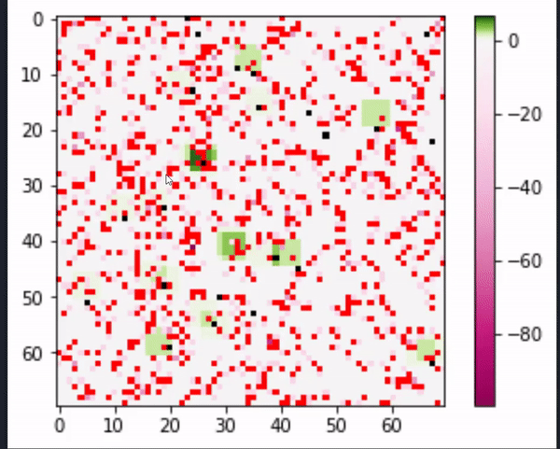
Results
The system was able to consistently retrieve 18 – 23 of 24 within 100 epochs objects once tuned.
Notes:
Robustness
Beacon Grad guides in low population density
Negative ph strength is guiding for high population density
New territory for high population density

Slide 9
Conclusion
Accomplishments:
  Demonstrates collaborative search and retrieval in a CA
  Interesting complex system behavior
    Roubustness
    Emergent complexity
Challenges:
  Non-intuitive behavior
  Sensitivity to initial conditions
Open Issues:
  Further testing required to fully characterize performance
  Good opportunity for exploring evolutionary optimization

Slide 10
References
Cao M., et al. (2015). A new discovery of transition rules for cellular automata by using cuckoo search algorithm. International Journal of Geographical Information Science, 806-824.
Hiraga, M., Wei, Y., & Ohkura, K. (2020). Evolving collective cognition for object identification in foraging robotic swarms. Artificial Life and Robotics, 1-8.
Lima, D. A., & Oliveira, G. M. (2017). A cellular automata ant memory model of foraging in a swarm of robots. Applied Mathematical Modelling, 47, 551-572.
Oliveira, G. M., Silva, R. G., Ferreira, G. B., Couceiro, M. S., Do Amaral, L. R., Vargas, P. A., & Martins, L. G. A. (2019, June). A cellular automata-based path-planning for a cooperative and decentralized team of robots. In 2019 IEEE Congress on Evolutionary Computation (CEC) (pp. 739-746). IEEE.

